Slide 1

Authorization Flow Research
User Testing for Orchid Virtual Agent – March 2022

Slide 2

User Testing Background & Scope
Authorization Flow Research (User Testing) | 03, 25, 2022
This round of user testing concentrated on the Virtual Agent’s authorization flows between pre- and post-authorization chat environments.
Users were asked to navigate, interact with, and explain their thought processes relating to situations where sign-ins and sign-outs are required.

Slide 3
User Testing Methods and Format
Authorization Flow Research (User Testing) | 03, 25, 2022
The team conducted 5 remote, moderated user testing sessions from March 18 – March 21, 2022.
The testing plan guided users through five separate tasks:
Locating the Virtual Agent on VA’s ”Contact Us” page,
Signing in to a post-authorization chat environment,
Chatting with the Virtual Agent in a post-authorization chat environment,
Signing out of the post-authorization chat environment, and
Re-accessing the Virtual Agent after having signed out.
User testing also featured:
Warm up questions to evaluate the users’ familiarity with VA technology
Post-task interview questions to gauge the users’ sentiment about the chat experience
SUS questionnaire to evaluate the usability of the task

Slide 4
Task Findings & Recommendations

Slide 5
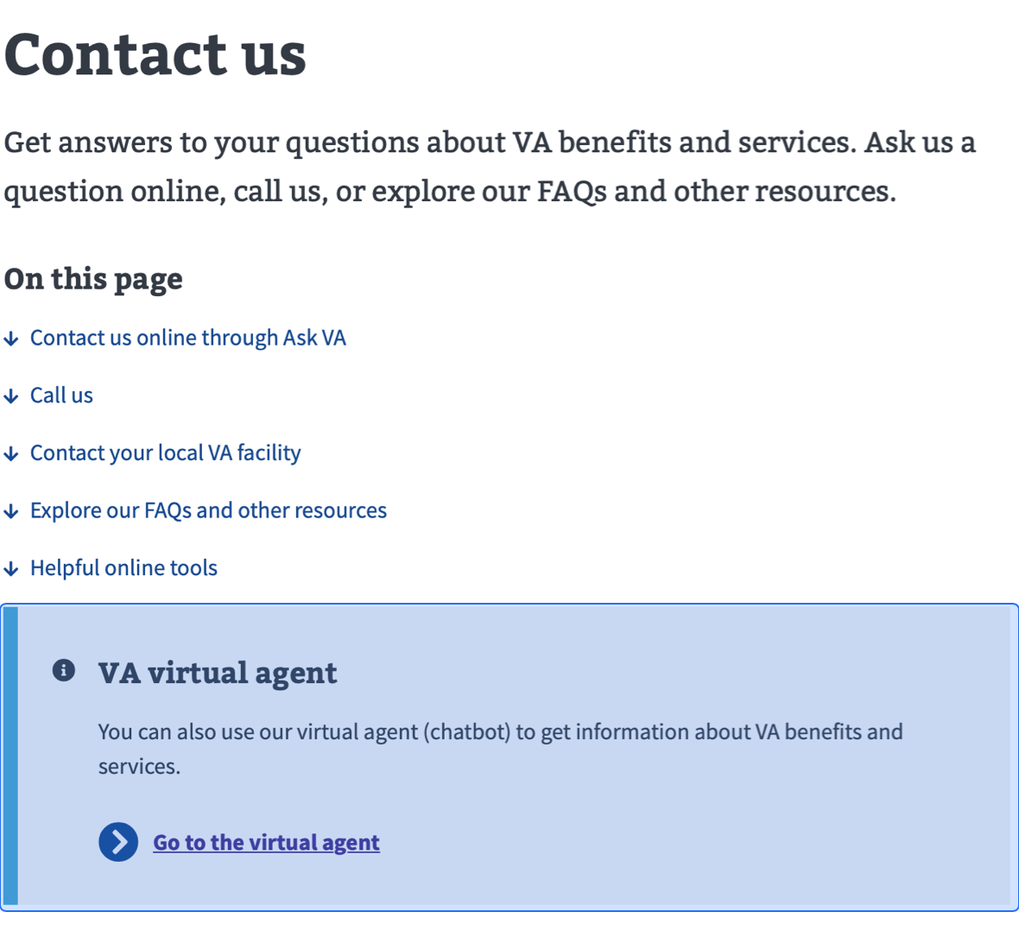
Group Virtual Agent Closer to Other Contact Options
Authorization Flow Research (User Testing) | 03, 25, 2022
Users eventually located the Virtual Agent option on the ”Contact Us” VA.gov webpage, but the Agent’s location in the call-out web element was not immediately apparent.
Recommendation: Group the beta testing Virtual Agent access point in a similar manner as other contact channels.
“Now I see it – the VA Virtual Agent.”

Slide 6
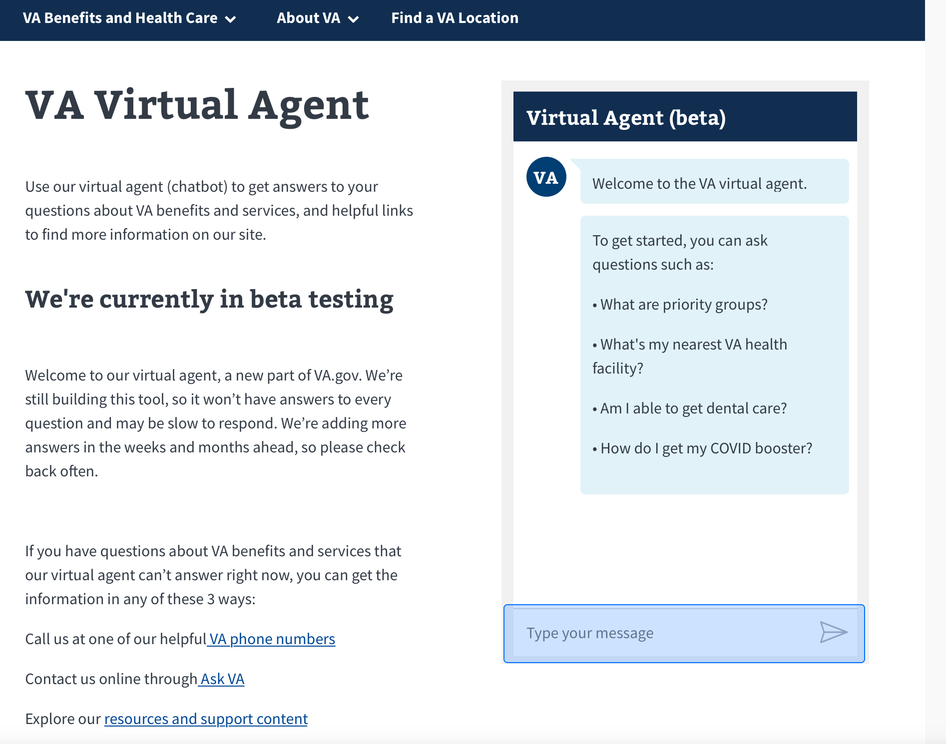
Position Virtual Agent at the Bottom Right of Screen
Authorization Flow Research (User Testing) | 03, 25, 2022
Users described an ideal location for a Virtual Agent access point on their screens at the “bottom-right.”
Users also expressed desires for a chat experience that can collapse and minimize or follow the user during their browsing session.
Recommendation: Position a minimizable, roaming chat experience at bottom-right of browser screen.
“It typically stays at the bottom right side with an option to pop out into its own window.”

Slide 7
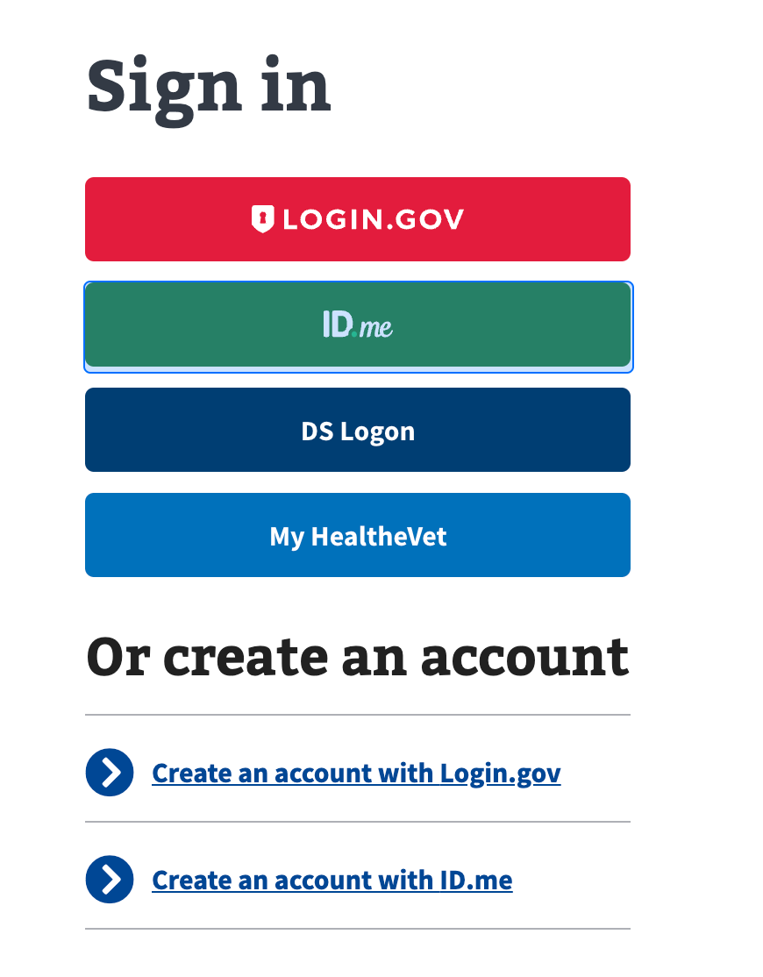
Prioritize the ID.me Sign In Option
Authorization Flow Research (User Testing) | 03, 25, 2022
Only one user saw that VA requires the ID.me login. Other users noted having and using alternative login options.
However, all users were able to figure out how the login process works.
Recommendation: Move the ID.me sign in button to the top and include error messages if users attempt to sign into the Virtual Agent with alternative accounts.
“My login is usually the DS Logon so that is what I would click on.”

Slide 8
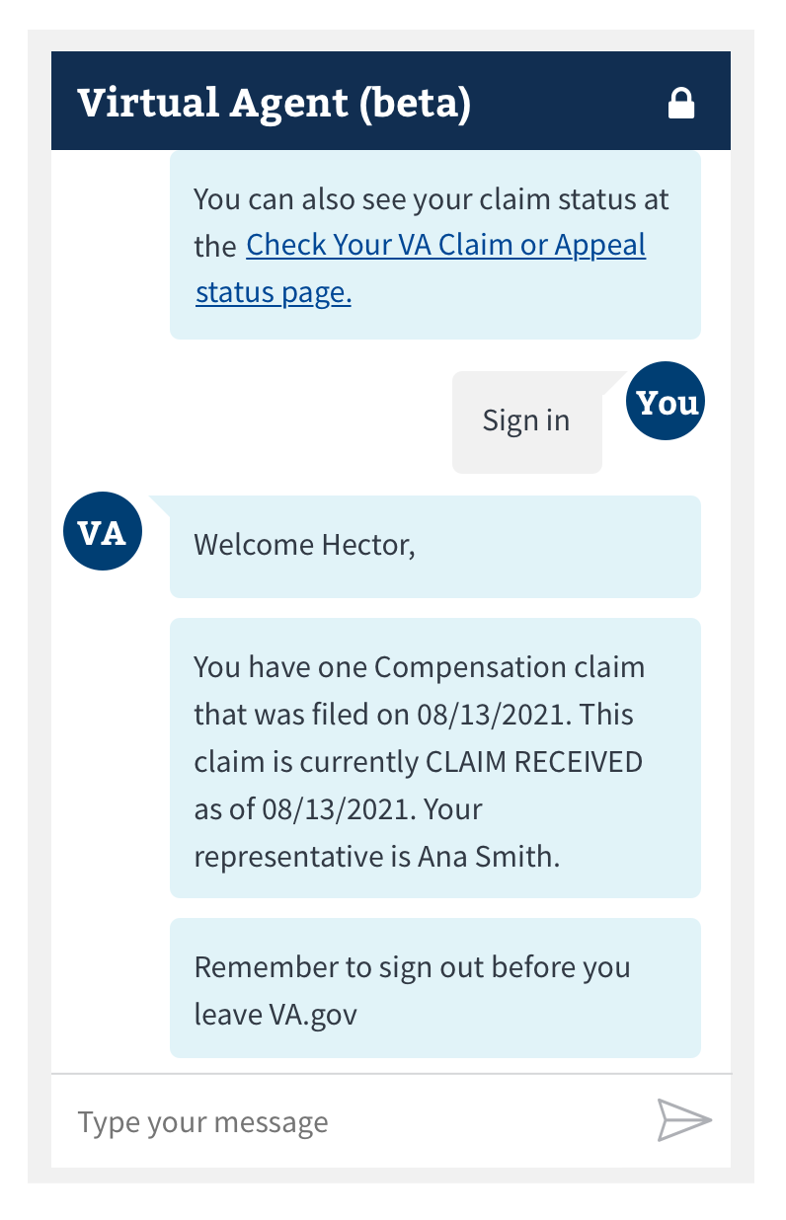
Remove the Lock Icon in the Chat Window
Authorization Flow Research (User Testing) | 03, 25, 2022
None of the users noticed the lock icon at first glance. Most users identified being logged in by seeing the “Hector” name in the top right corner of the page.
Recommendation: remove the lock icon in the chat window
“Are you talking about the lock? I didn’t even see that last time.”

Slide 9
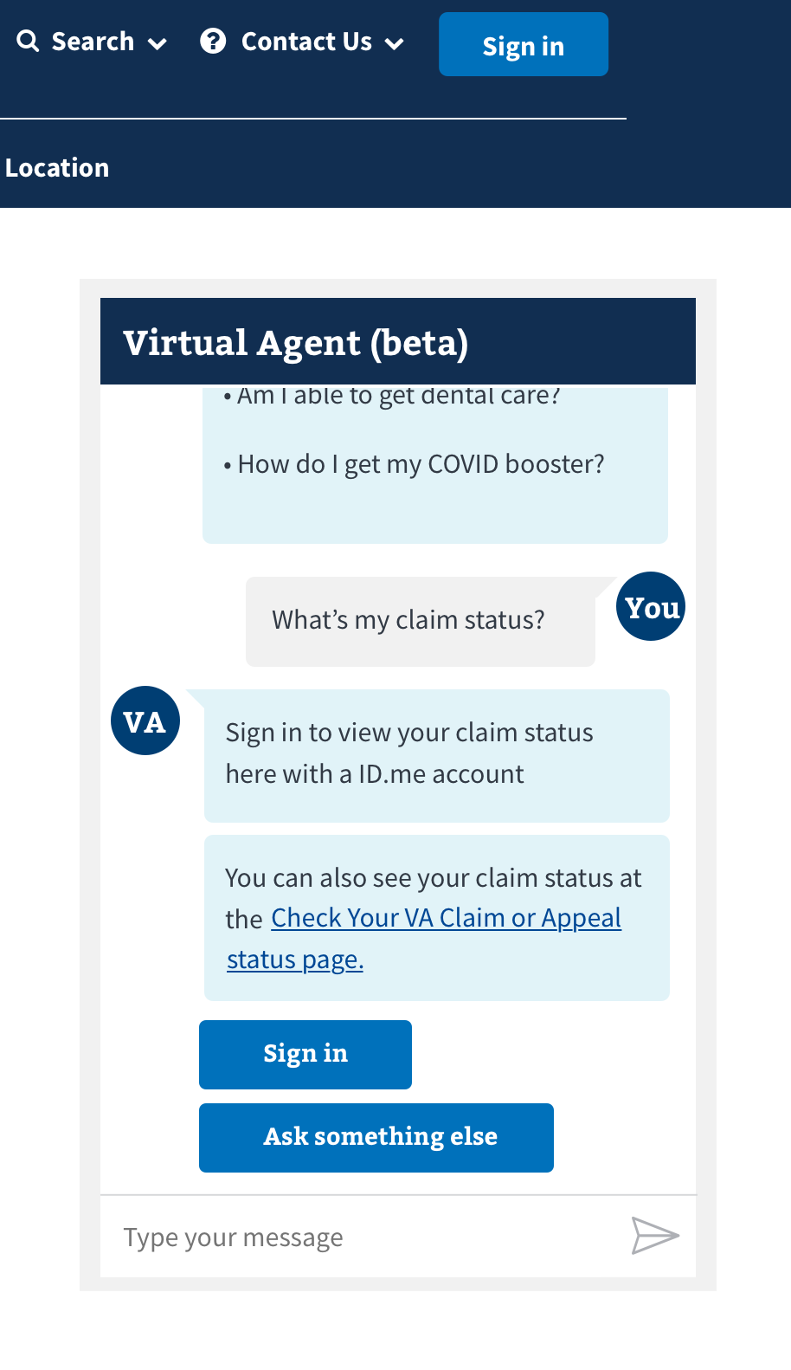
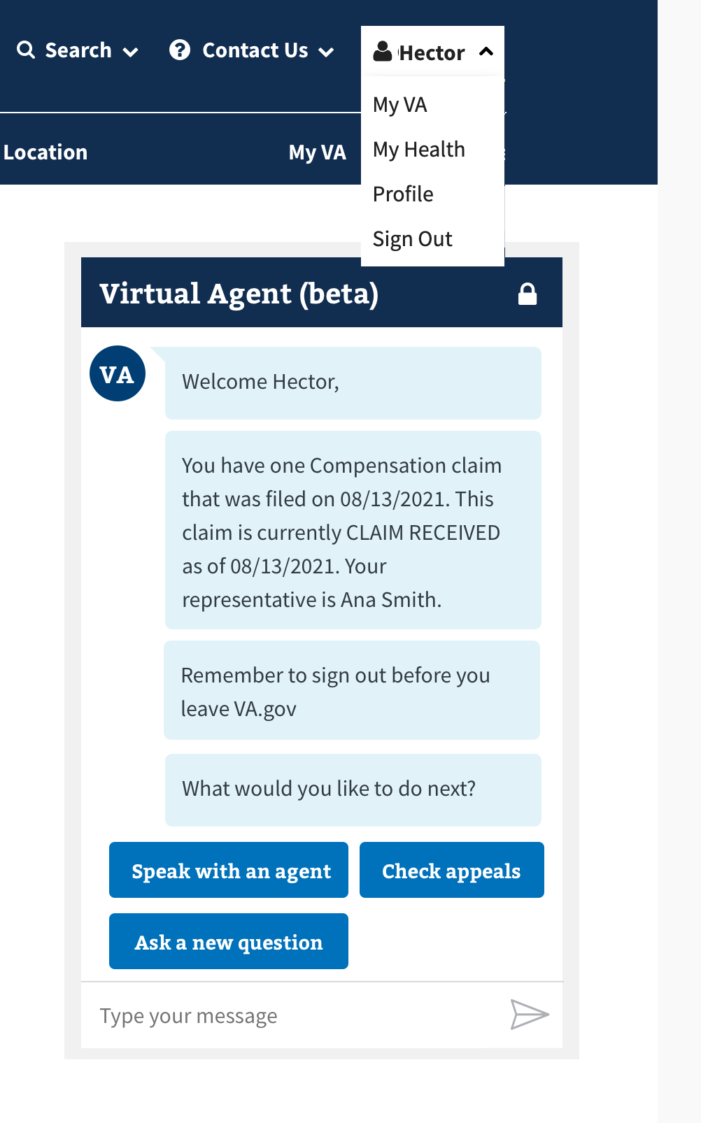
Add a Sign Out Button as an Option in Virtual Agent
Authorization Flow Research (User Testing) | 03, 25, 2022
Most users expected a blue sign out button to be available within the Virtual Agent. After the initial confusion, users signed out from the navigation bar.
Users also expressed that after their Virtual Agent interaction, they would explicitly sign out of their profile.
Recommendation: Add a sign out button as an additional option in actions that the Virtual Agent presents to the user.
”If you gave me a blue bubble to sign in, I would expect another blue bubble to sign out, or if you are done with the chat click here.”

Slide 10
SUS Questionnaire Results

Slide 11
System Usability Score
Authorization Flow Research (User Testing) | 03, 25, 2022
I think that I would like to use this system frequently.
I found the system unnecessarily complex.
I thought the system was easy to use.
I think that I would need the support of a technical person to be able to use this system.
I found the various functions in this system were well integrated.
I thought there was too much inconsistency in this system.
I would imagine that most people would learn to use this system very quickly.
I found the system very cumbersome to use.
I felt very confident using the system.
I needed to learn a lot of things before I could get going with this system.
Set of 10 questions used to measure usability.
Used for quantifying the ease of use experience of a system across multiple iterations.
Participant Tracker on Google Sheets

Slide 12
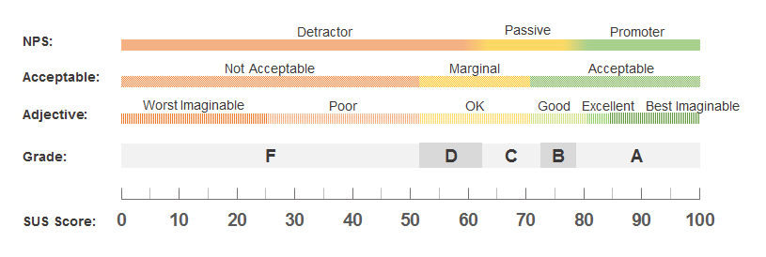
System Usability Score
Authorization Flow Research (User Testing) | 03, 25, 2022
Avg. Score: 88
Next steps:
Means the design is good to go and passes with honors the usability standard.
If this is revisited, use as point of comparison between alternative solutions / designs.

Slide 13
Other Observations

Slide 14
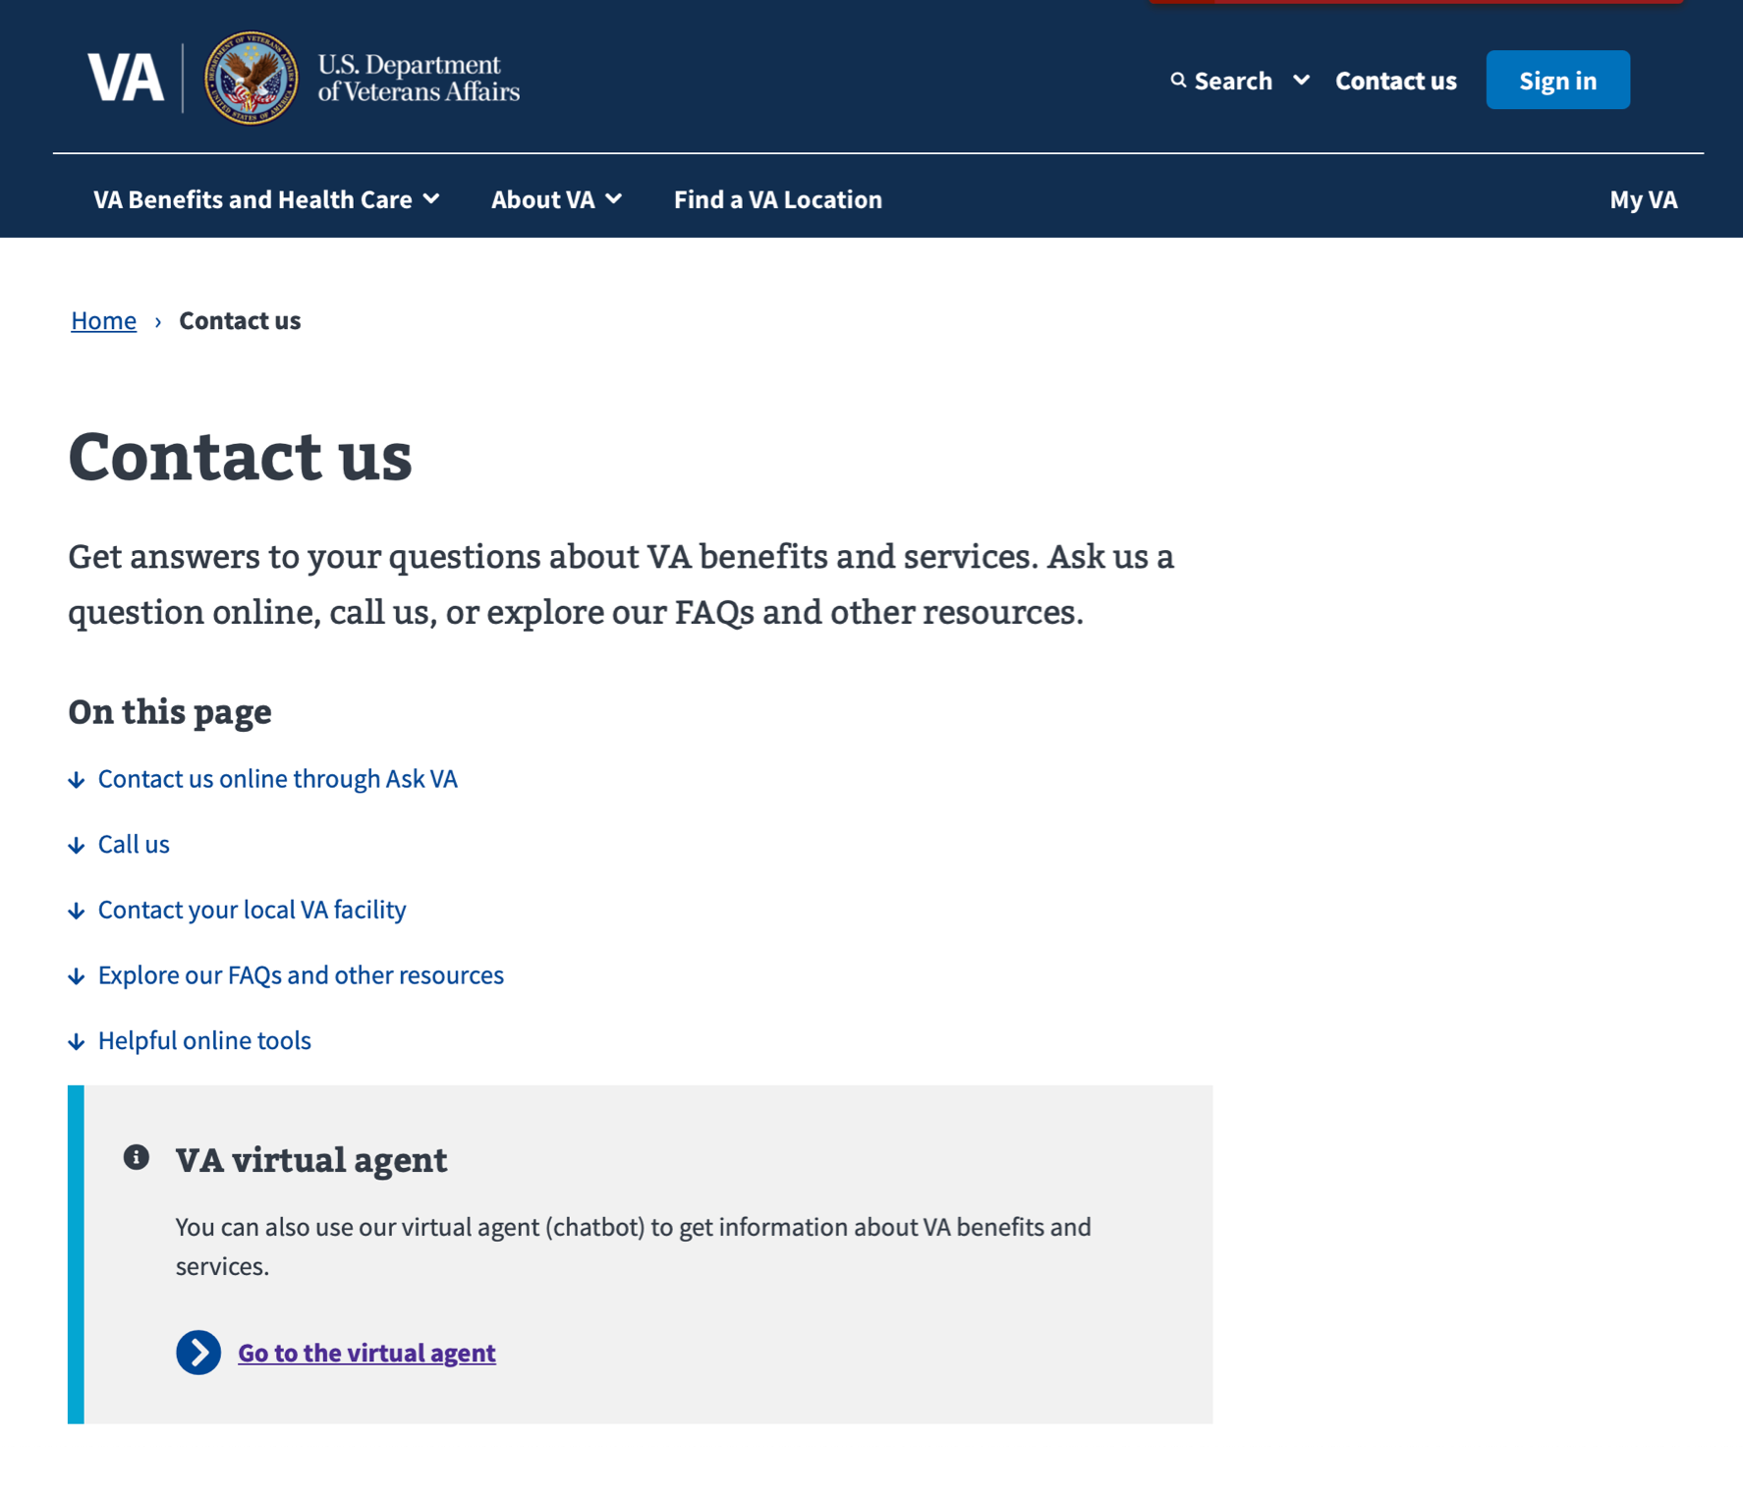
Users Expected the Virtual Agent to Behave as a Persistent, Floating Window
Authorization Flow Research (User Testing) | 03, 25, 2022
2/5 users felt finding the Virtual Agent was buried.
4/5 users expected the Virtual Agent to be a chat pop-up application, likely in the bottom right corner.
“It typically stays at the bottom right side with an option to pop out into its own window."

Slide 15
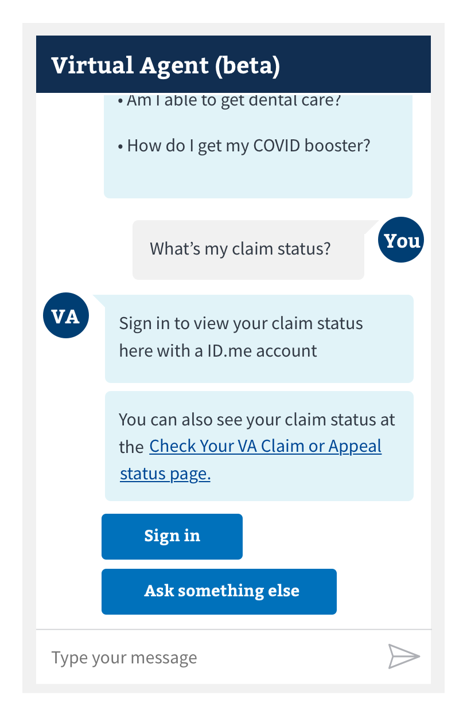
Users Had Varying Expectations for Sign In Behavior
Authorization Flow Research (User Testing) | 03, 25, 2022
There was no consensus on how users expected the sign in flow to behave.
1/5 users expected to sign into their account within the Virtual Agent.
2/5 users expected to be redirected to a separate sign in page.
1/5 users expected to be presented with sign in choices.
“I would expect it to lead me deeper into the box otherwise it wouldn’t make sense to have the link to check status or appeal page.”
“I would expect it to open a next page to take me to the sign in.”

Slide 16
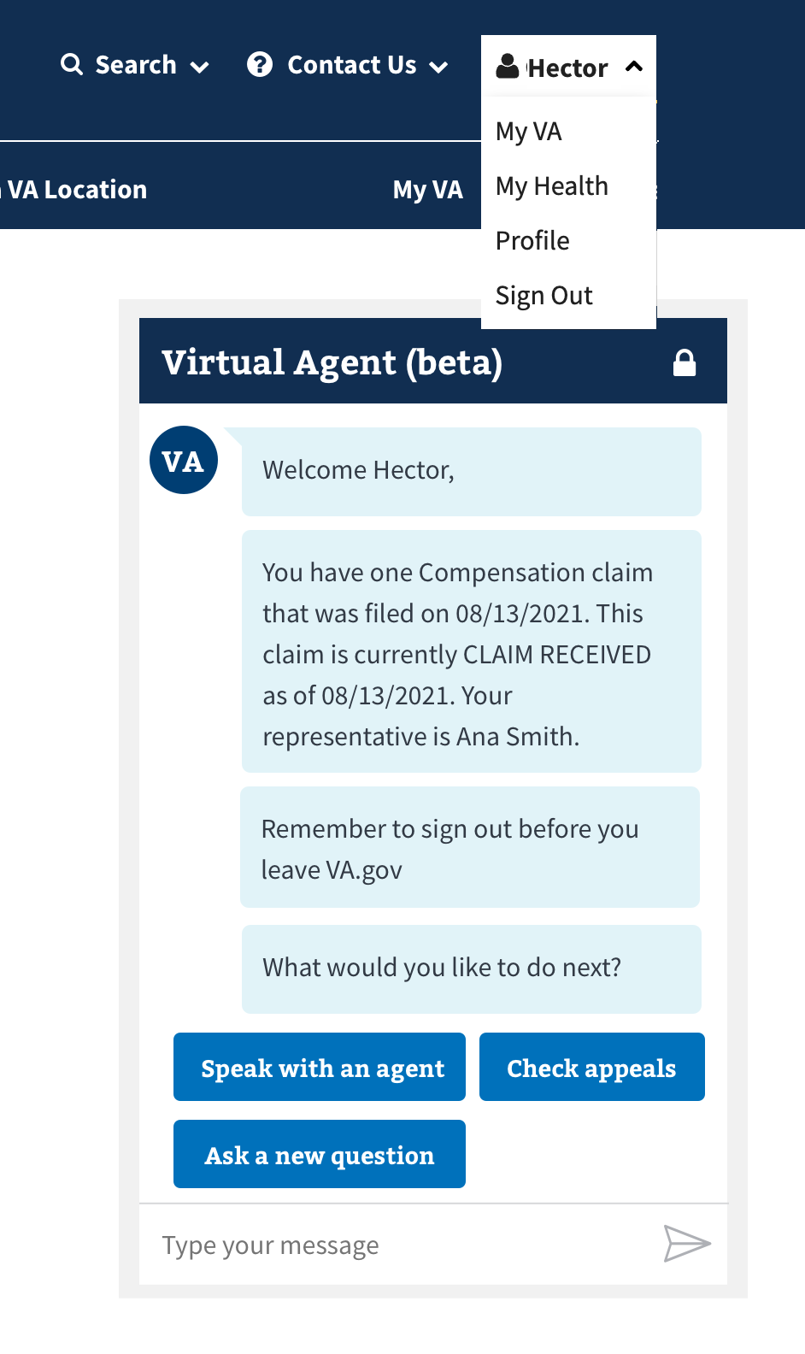
All Users Overcame the Lack of a Blue Sign Out Button
Authorization Flow Research (User Testing) | 03, 25, 2022
All users were able to sign out of their account even though a blue Sign Out button was lacking in the chat window.
3/5 users navigated to the Hector profile drop-down menu to sign out.
2/5 closed out the page.
“I will tell you what I notice, it tells me to not forget to sign out, but it does not provide a place to sign out of chat so I would go to my name and click sign out there. My initial thing would be to just close the chat, but there is no way to close out so I would go to sign out of my account.”

Slide 17
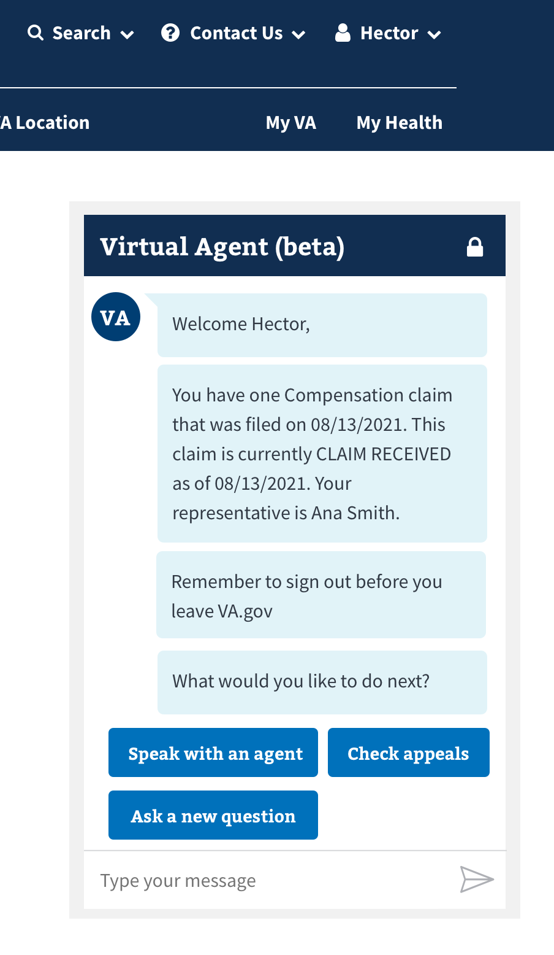
Users Were Split on the Virtual Agent Remembering Chat History
Authorization Flow Research (User Testing) | 03, 25, 2022
2/5 users expected some form of chat history retention when signing back in.
All users did not expect the chat history to be retained after signing out of their profile.
“It would pop up again almost identical to how it looked when I signed out. Hopefully, a recap of what had just gone on instead of going back to the beginning.”

Slide 18
Appendix

Slide 19
Project Team
Authorization Flow Research (User Testing) | 03, 25, 2022
Luciana Morais, DSVA Virtual Agent Project Manager
Shane Strassberg, DSVA Virtual Agent Deputy Project Manager
Pilar Moreno, Thoughtworks Experience Designer
Daniel Kim, Booz Allen HCD Researcher
Patrick Onesty, Booz Allen HCD Researcher

Slide 20
Slide Graveyard

Slide 21
Observation billboard headline
Authorization Flow Research (User Testing) | 03, 25, 2022
Observation description.
Screenshot of relevant observation visual. If none exists or if none is needed, extend observation description horizontally across screen.
Quote from user testing session speaking to observation.

Slide 22
Project Leads
Authorization Flow Research (User Testing) | 03, 25, 2022
Luciana Morais, DSVA Virtual Agent Project Manager
Shane Strassberg, DSVA Virtual Agent Deputy Project Manager
Kevin Clawson, MCT Omnichannel Project Manager

Slide 23
Brief Billboard Headline of Recommendation
Authorization Flow Research (User Testing) | 03, 25, 2022
Brief description of user situation and why.
Recommendation: This is where the recommendation goes
Screengrab of mockup of whatever’s being recommended.
Quote from user testing session.

